Slide 1

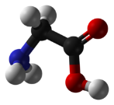
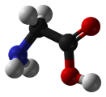
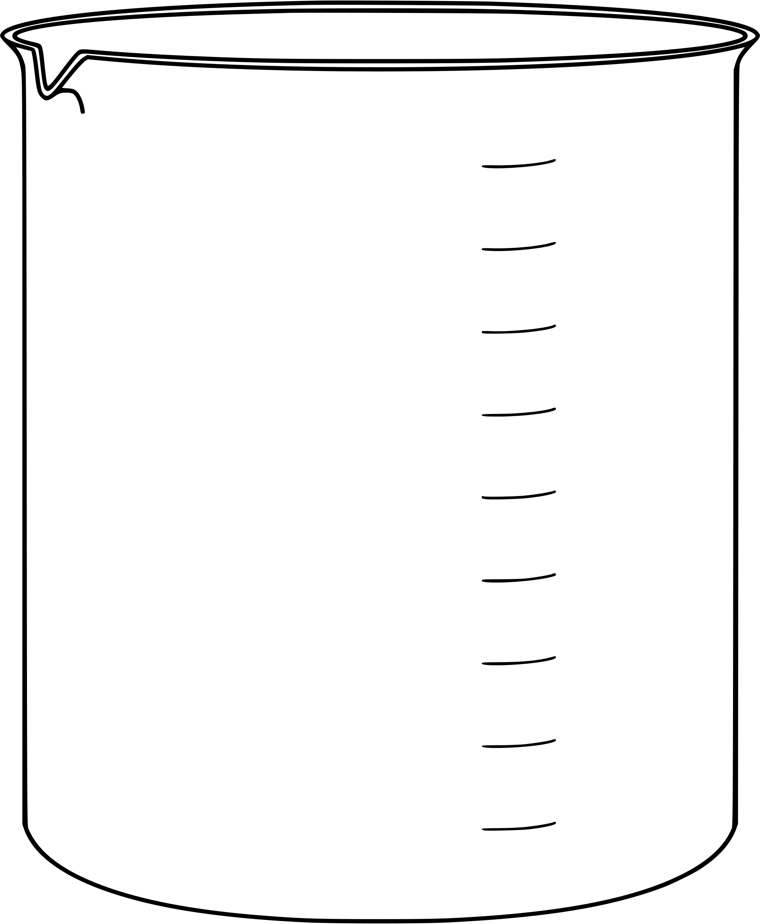
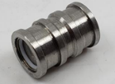
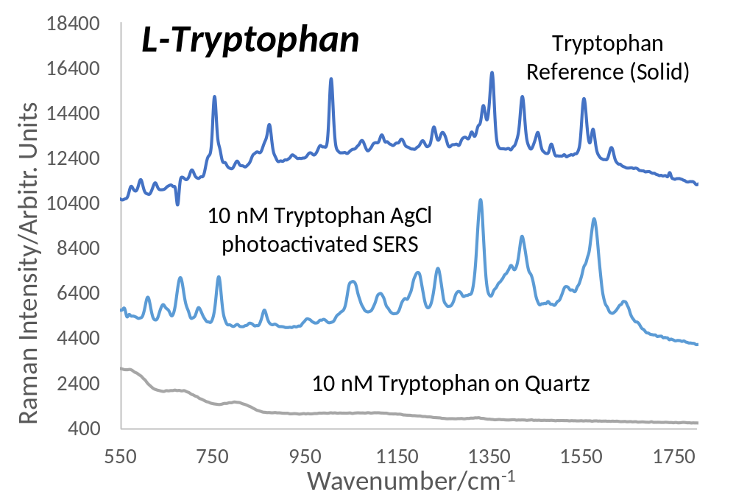
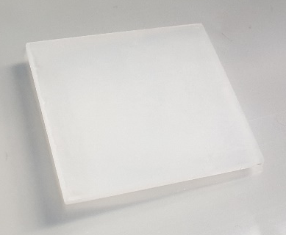
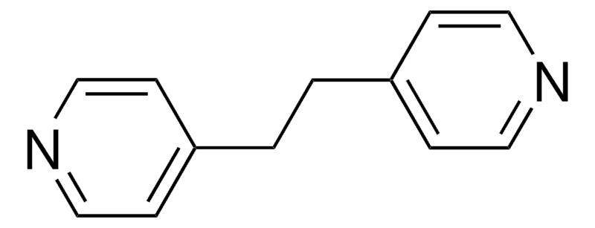
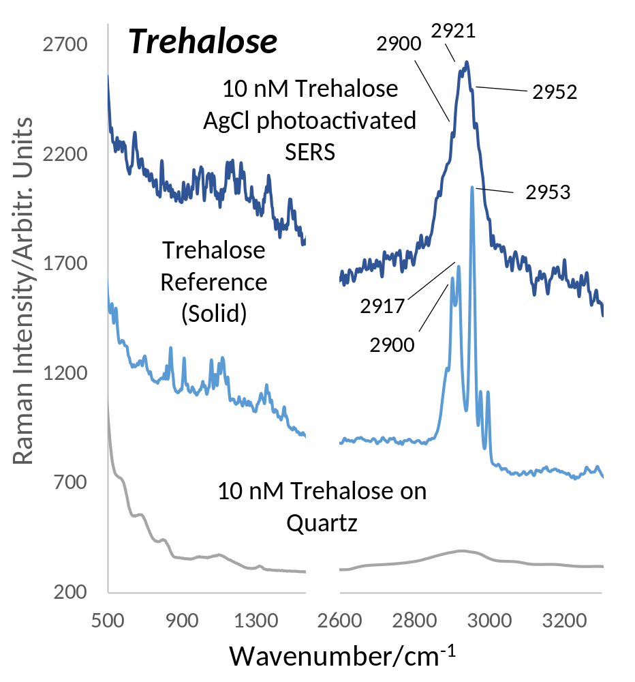
National Aeronautics and Space Administration
Postdoc Research
In-Situ Photoactivated Surface Enhanced Raman Spectroscopy for Biosignature Detection at Extremely Low Concentration on Ocean Worlds and Mars
Author: Aria Vitkova (365K, NASA Postdoctoral Fellow)
Co-Authors: James Lambert (365K), Tuan Vu (322F)
Background
Objectives
One of the challenges of biosignature detection on Ocean Worlds or in Martian water/ice is the very low concentration of biomolecules expected in the sampled material. Raman spectroscopy is already a popular tool for mineralogy in planetary exploration as well as on Earth with unique capability to also detect organics, however, not at trace concentrations as required. Surface Enhanced Raman Spectroscopy (SERS) allows up to single molecule detection but is traditionally not considered compatible with long duration spaceflight due to SERS substrate degradation. In this work we advance an in-situ activated SERS method developed for JPL’s CIRS instrument that relies on a chemically stable AgCl precursor coating, which is then activated into SERS active Ag nanoparticles in-situ, thus preventing any substrate degradation during transit and allowing biosignature detection at ppb level without introducing any additional cost or complexity.
Biomolecule Concentration:
Martian regolith: 3500 to 1 ppm
Europa: ~ppb and as low as 0.01 ppb
This project aims to advance and validate the in-situ photoactivated SERS method for biosignature detection on Ocean Worlds and Mars:
Laser Excitation
Enhanced Raman Signal
Sample Molecules
Test different biosignature species at representative (ppb) concentration
Test the reproducibility and stability of the SERS spectra
Optimise the substrate fabrication
Assess environmental effects (pH/presence of salts)
SERS Active Material (e.g. Ag NPs)
Substrate
Localized Surface Plasmon
Approach and Results
AgCl In-situ photoactivated SERS method coating process
Detectability of Biosignatures at ppb Concentration
Stability and Reproducibility – stable, visible degradation only after 44min
Quartz Substrate
10-50 1s cycles
AgCl coated quarts substrate
532 nm Laser
Sample Cup
SERS Measurement
0.1M AgNO₃
0.1M NaCl
In-Situ Activation
Modified from A. Matikainen et al., Sci. Rep., vol. 5, p. 8320, 2015
Detection Limit - Polyaromatics detectable at yM (10⁻²⁴ M)!
[2]
Salts/pH – salts improve the signal!
[1]
[1]
Significance of Results/Benefits to NASA/JPL
AgCl in-situ SERS method is an effective, cheap, light-weight and simple addition to CIRS that allows detection of relevant molecules for the exploration of Ocean Worlds and Mars at the required concentration (~ppb). It is particularly beneficial for missions that aim to examine a mixture of rocky and icy samples and already have a need for Raman spectroscopy for mineralogy. As an add-on feature at no significant extra cost or complexity, this method represents a highly innovative low risk/high return out-of-the-box solution for life detection.
[1]
Future Work
Further testing of different molecular species, implementing Serially Shifted Excitation (SSE) algorithm for fluorescence suppression and optimizing the coating process.
National Aeronautics and Space Administration
Jet Propulsion Laboratory
California Institute of Technology
Pasadena, California
www.nasa.gov
[2]
[1]
Publications and Acknowledgements:
[1] A. Vitkova, T. Vu, and J. Lambert, “Extended Longevity Photoactivated Surface-Enhanced Raman Spectroscopy for the Detection of Biosignatures on Icy Worlds and Martian Polar Caps“. J Raman Spectrosc., ICORS Special Issue, 2025, https://doi.org/10.1002/jrs.6790
[2] A. Vitkova, T. Vu, J. Lambert, “Enabling Biosignature Detection at Extremely Low Concentrations on Ocean Worlds and Mars Using In-Situ Photoactivated Surface Enhanced Raman Spectroscopy”, Proceedings of 76th International Astronautical Congress, 2025
Author Contact Information:
aria.vitkova@jpl.nasa.gov, (347) 438 6447
Clearance Number: CL#00-0000
Poster Number: Postdoc-T-015
Copyright 2025. All rights reserved.

